Slide 1
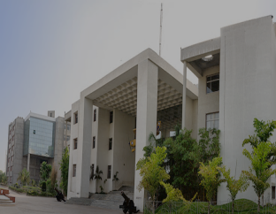

Raspberry Pi: An Introduction
INDUSUNIVERSITY
Presented By
Ami Goswami IU1241090014
Vatsal Shah IU1241090055
Electronics & Communication Dept.
8th Semester
INDUS UNIVERSITY, AHMEDABAD

Slide 2

Everybody has a dream to program their own computer

Slide 3
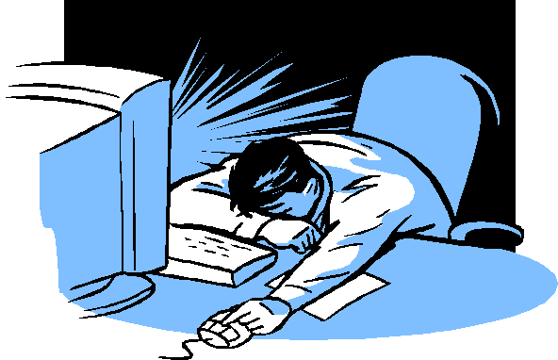
But most of them failed to do it….☹

Slide 4
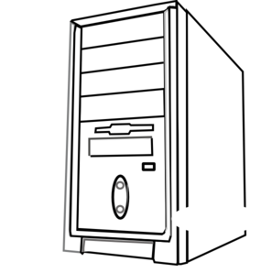

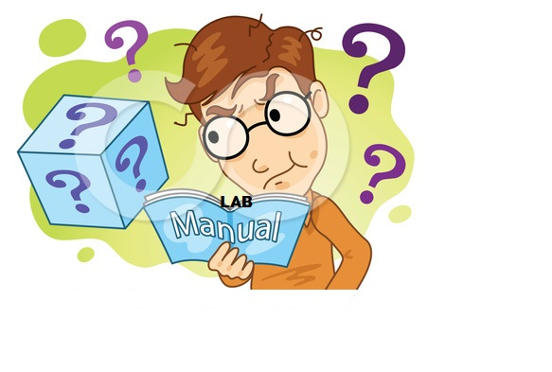
PROBLEMS :-
1.Not much idea on what is inside the CPU
2.Not much knowledge in practical programming

Slide 5
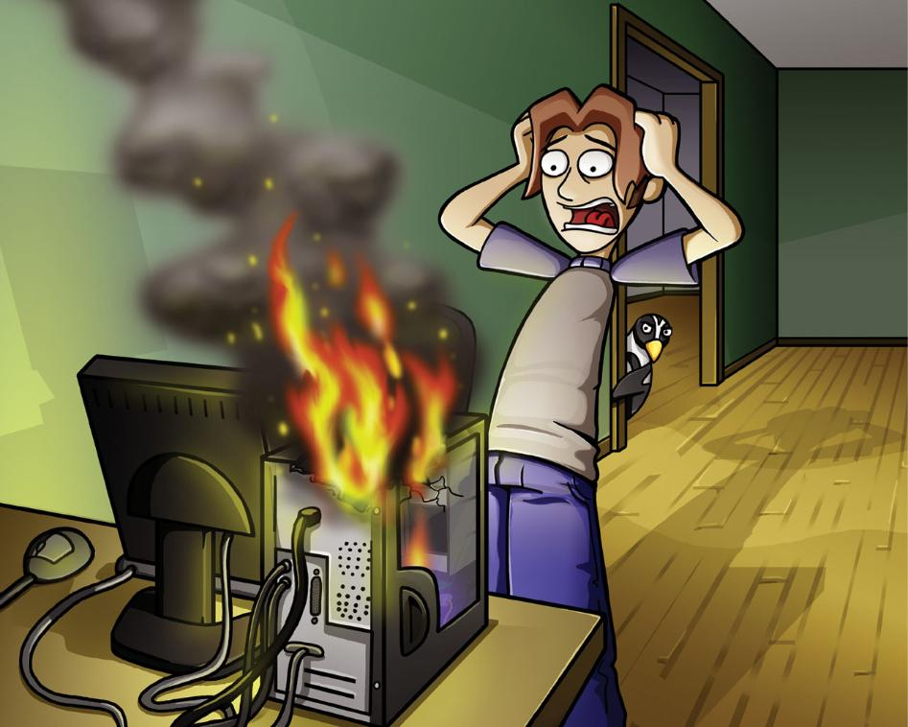
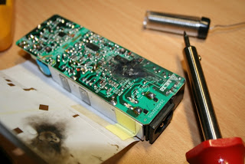
PROBLEMS :-
3.Scared to play with the H/W because of the expensive components inside the CPU

Slide 6

But still they have a chance to
get their dream come into action

Slide 7
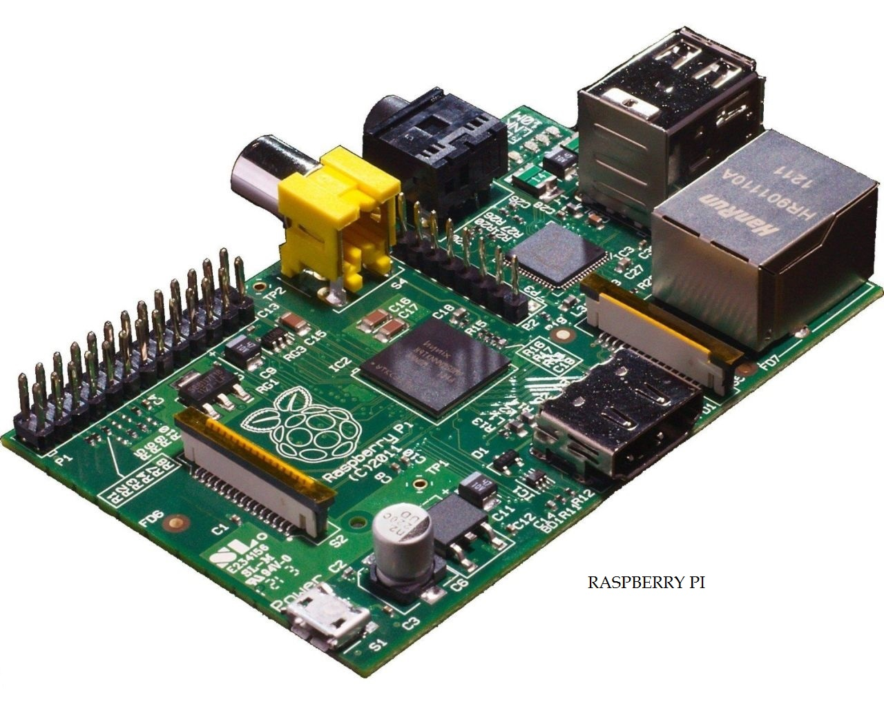
HERE WE GO HOW IT IS ! !

Slide 8
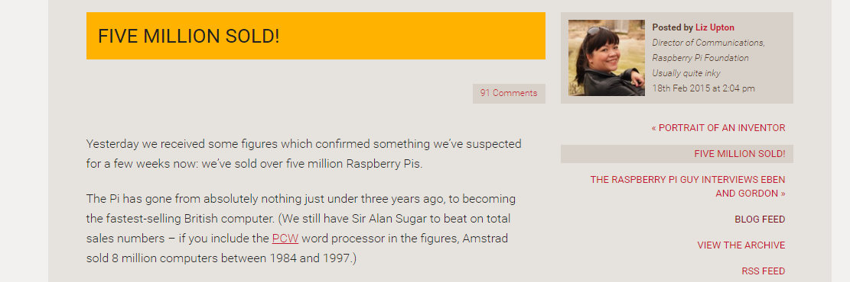
Reality…!

Slide 9
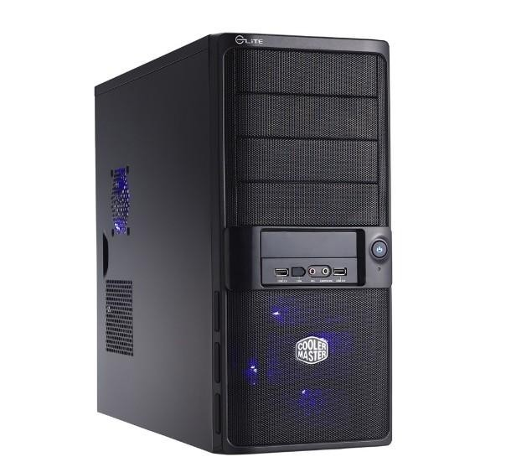
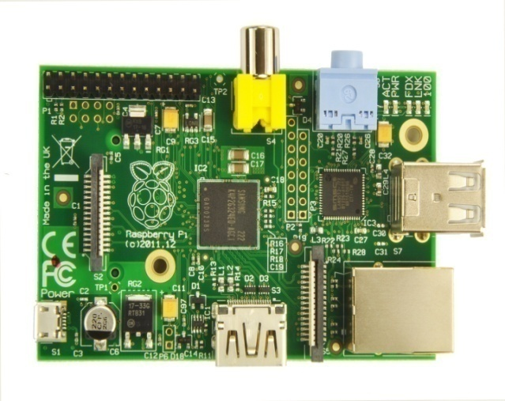

WHAT IS IT….?
Well this is Raspberry Pi, a credit-card-sized single-board computer developed in the UK by the Raspberry Pi Foundation with the intention of promoting the teaching of basic computer science in schools
2. Despite its diminutive device, Raspberry Pi is powerful enough to process many of the same programs as PCs, from word processors to games. Its small size also makes Raspberry Pi ideal for programming connected home devices.

Slide 10
HISTORY BEHIND PI:-
Eben Upton first came up with the idea for Raspberry Pi in 2006, when he and his colleagues at the University of Cambridge’s Computer Laboratory were frustrated by the dwindling number of students, and the poor skill levels of those students, entering the program.
2. Upton wanted to create a cheap, easily programmable computer that would bring back the experimental spirit of an earlier era of computing, by making a Device cheap enough so anyone could tamper with it without fear of expensive mistakes.

Slide 11
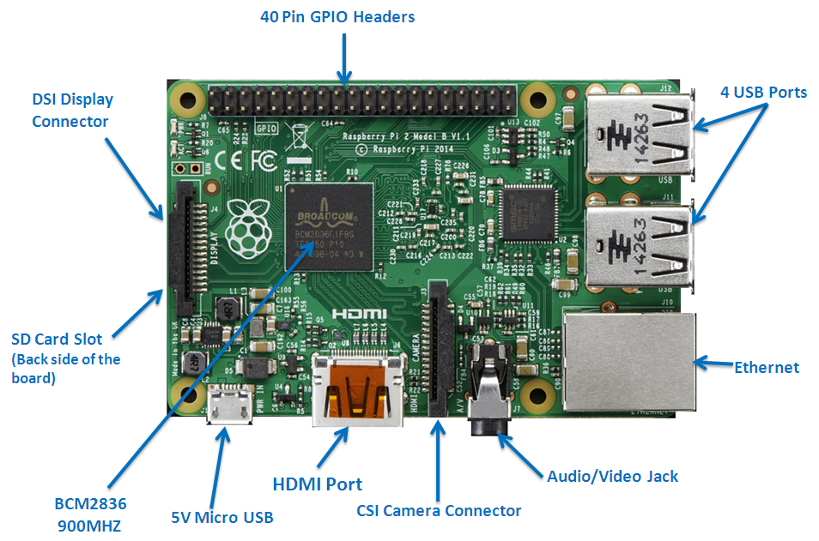

Slide 12
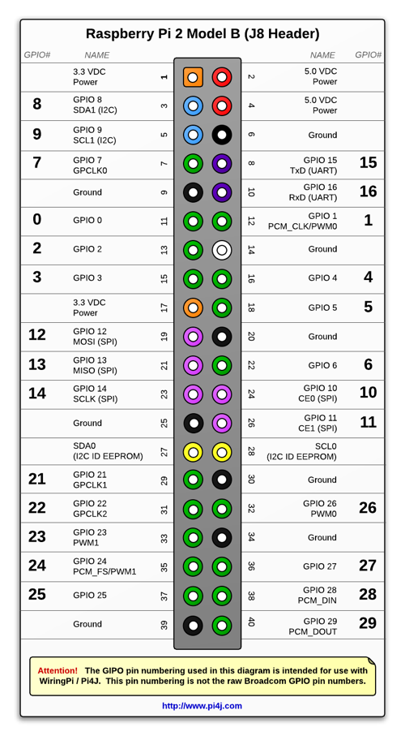
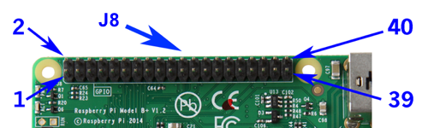
Pin Connection

Slide 13
Features
Ultra low-cost (Model A $25, Model B $35)
Ultra low-power ~1W
Credit-card sized, instant start-up
Complete easy-to-program computer
Provide a fun environment for experimenting with programming and electronics
Inexpensive, simple, open and easy to maintain computer for schools

Slide 14
Technical features of PI
PI is available in two modules A and B
Dimensions | 8.6cm x 5.4cm x 1.7cm
Chip | Broadcom BCM2835 SoC full HD multimedia applications processor
CPU | 700 MHz Low Power ARM1176JZ-F Applications Processor
GPU | Dual Core VideoCore IV® Multimedia Co-Processor
Memory | 512MB SDRAM
Ethernet | on-board 10/100 Ethernet RJ45 jack
USB 2.0 | Dual USB Connector
Video output | HDMI (rev 1.3 & 1.4) Composite RCA (PAL and NTSC)
Audio output | 3.5mm jack, HDMI
Onboard Storage | SD, MMC, SDIO card slot

Slide 15
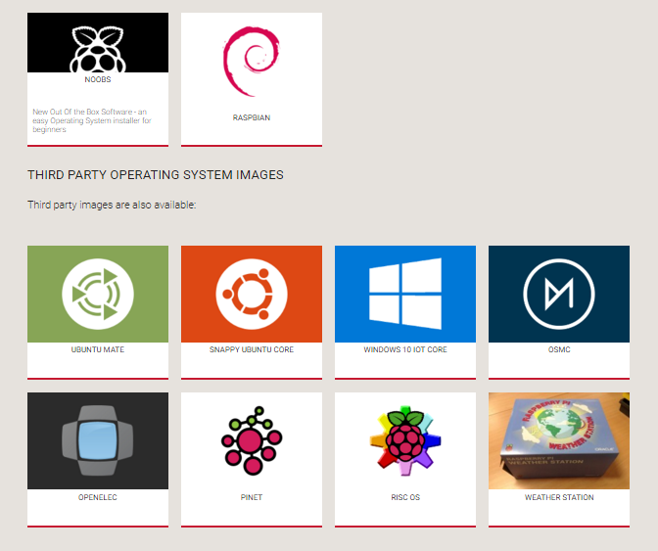
Operating System

Slide 16
Programming

Slide 17
How it helps us to get into programming..?
Tiny Basic Learn to program in the BASIC programming language with the Tiny Basic interpreter for the Raspberry Pi on Debian & Raspbian.
Python Python is a programming language that is available on the official Raspberry Pi operating systems.
Scratch Scratch is an entry-level programming language that comes as standard with the Raspberry Pi distribution, Raspbian. Scratch was originally created by the Lifelong Kindergarten Group at the MIT Media Lab in Boston, U.S., with an aim to help young people learn mathematical and computational concepts while having fun making things..
Java SE Embedded Provides Full Java SE runtime for headless embedded applications
C & C++ programming information It helps to know and execute C and C++ programming languages.
KidsRuby It provides Ruby programming application for the Raspberry Pi with tutorial and guides for kids.

Slide 18
Set up with laptop

Slide 19
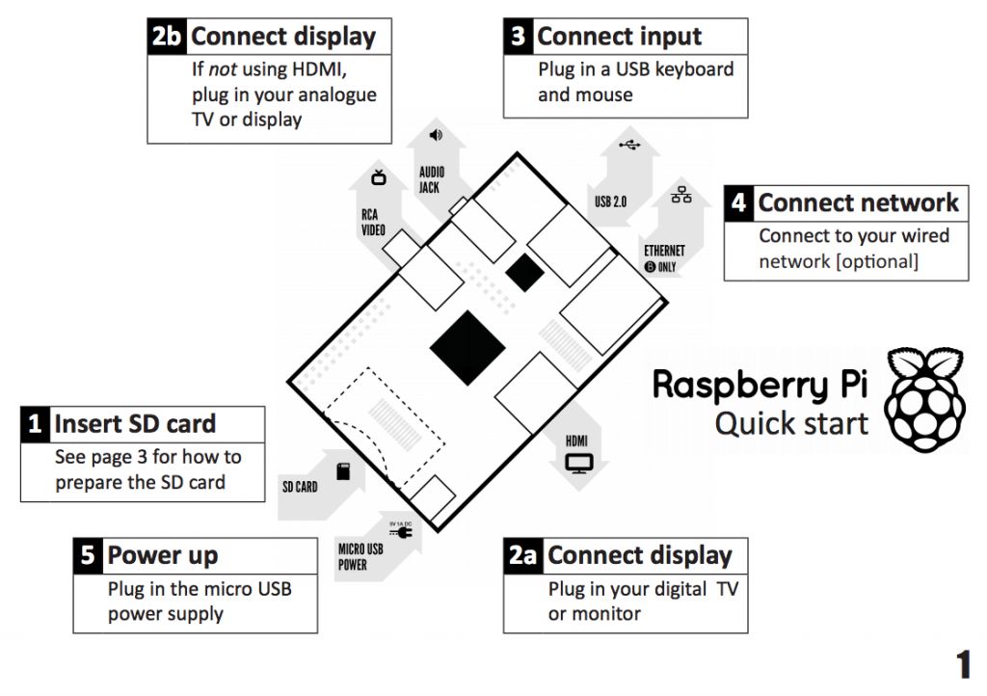

Slide 20
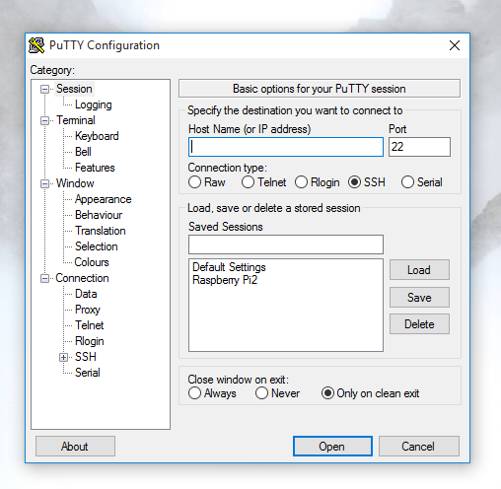
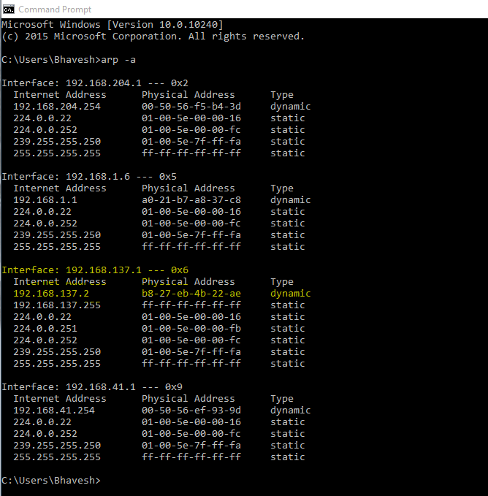
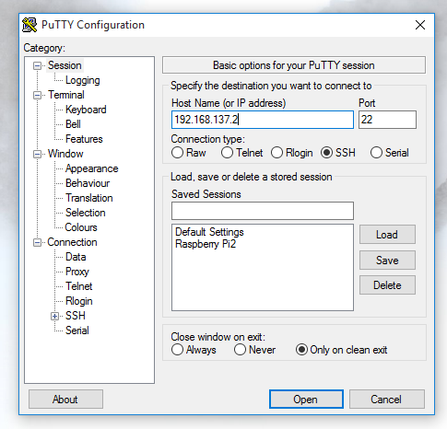
Open Putty Software
Find Rpi IP Address using arp -a
Enter IP address here…!

Slide 21
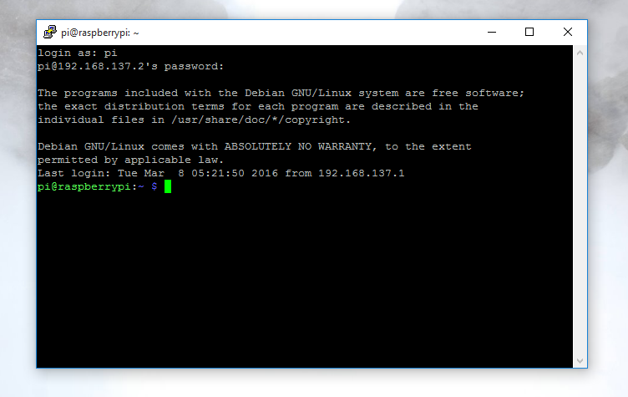
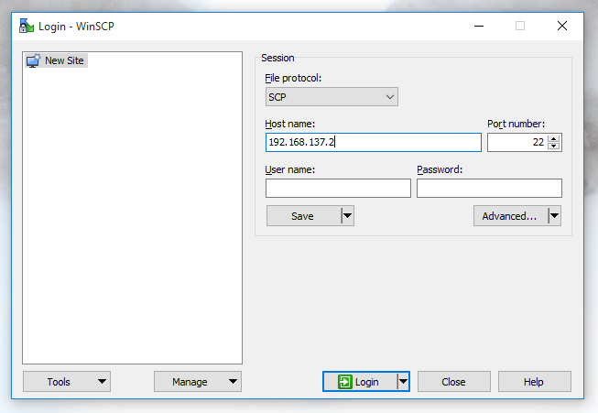
Enter Login name & password here and you can successfully enter in Raspberry CMD window.
New Software : WinSCP
Check file protocol: SCP
Enter Host name as Pi IP address.
Don’t Enter USENAME & PASSWORD HERE…!

Slide 22
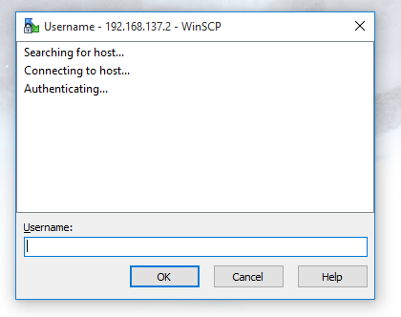
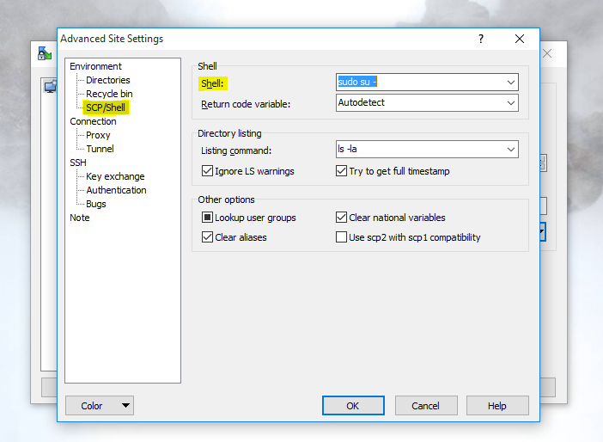
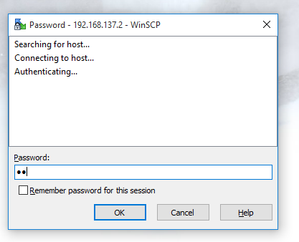
In SCP/Shell write “sudo su -” and press Ok.
Two screen shows for Username and password. Enter it.

Slide 23
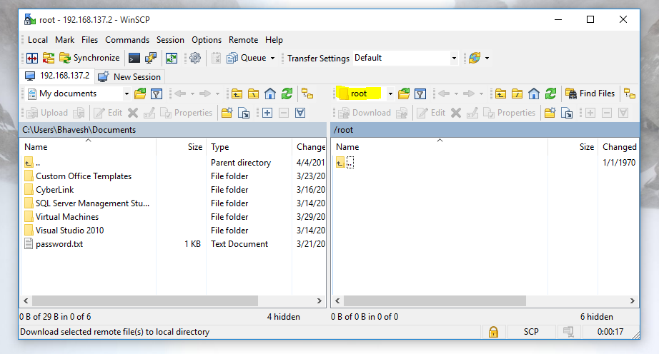
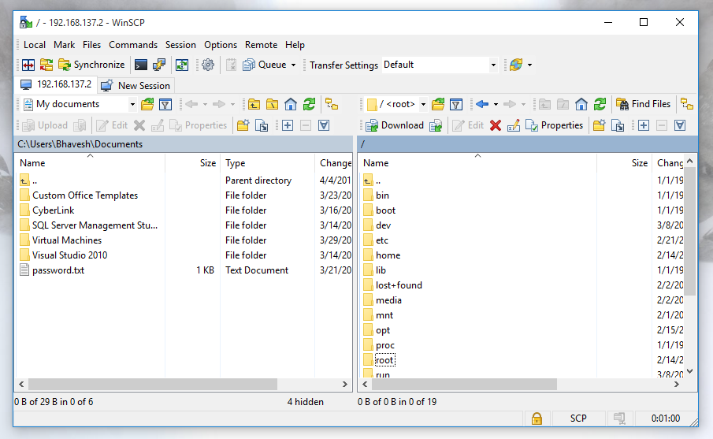
User able to work in “root” so transfer file from Laptop to Pi is easier.
User can access all files of Raspberry pi from Here…!

Slide 24
Demo_1: blink led

Slide 25
Disadvantages
It does not have a Hard Disk associated with it for permanent storage pi files, we have to connect one externally or have to use SD card for the purpose.
The RAM is a POP package on top of the SoC, so it’s not removable or swappable.
There is no Real time clock associated with the board. Adding an RTC is expensive. You can add one yourself using the GPIO pins.

Slide 26
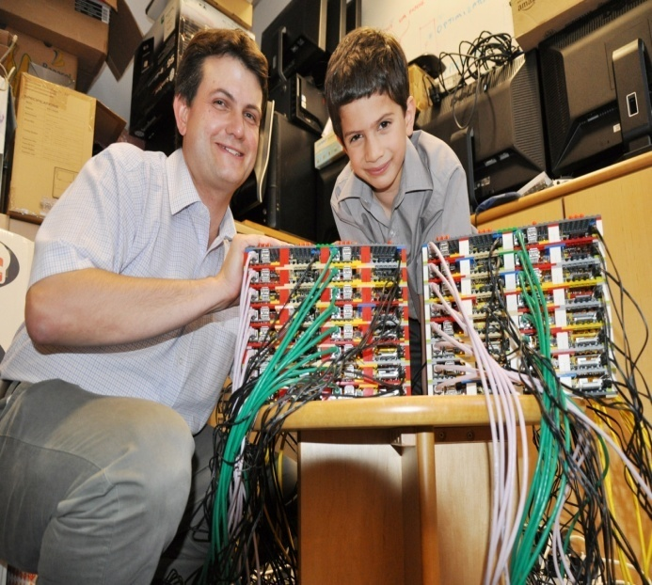

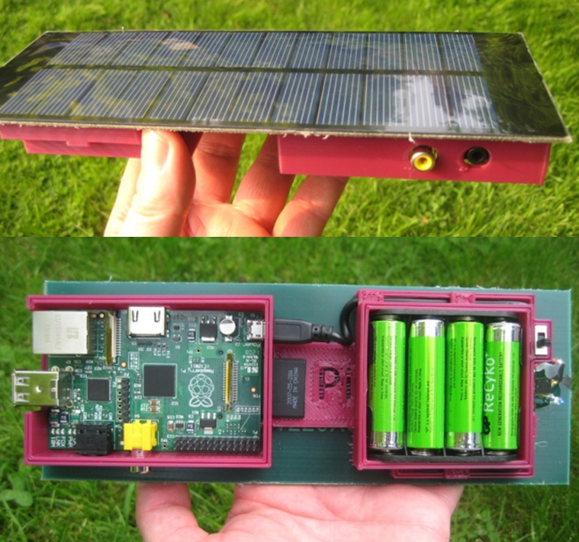
Applications
Can be used for making super computers
Voice-Activated Coffee Machine
Raspberry Pi Dynamic Bike Headlight Prototype
Solar Raspberry Pi Power Pack

Slide 27
Applications
It can make your Old TV in to a smart TV. (You can play Videos, 3D Games, Music, Browse Internet and much more.
Raspberry Pi can Act as Full HD 1080p Media Player.
You can connect a Monitor, Keyboard and Mouse and use it as a normal computer.

Slide 28
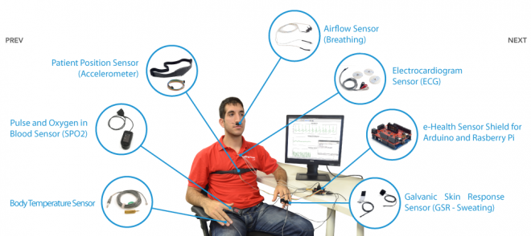
Raspberry Pi Medical Device Input Shield

Slide 29
References
http://en.wikipedia.org/wiki/Raspberry_Pi
http://www.raspberrypi.org
http://www.element14.com/community/groups/raspberry-pi
http://www.dummies.com/how-to/content/top-10-programming-languages-ported-to-the-raspber.html
http://raspberrypi.stackexchange.com/questions/23182/how-to-stream-video-from-raspberry-pi-camera-and-watch-it-live
http://www.oracle.com/technetwork/java/javase/downloads/jdk7-arm-downloads-2187468.html
http://blog.miguelgrinberg.com/post/stream-video-from-the-raspberry-pi-camera-to-web-browsers-even-on-ios-and-android
http://webiopi.trouch.com/

Slide 30


Slide 31
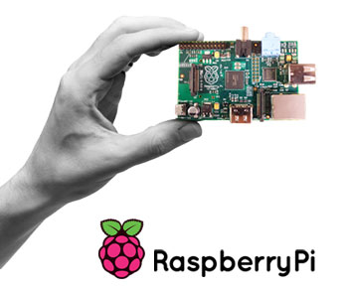
THANK YOU

